Slide 1

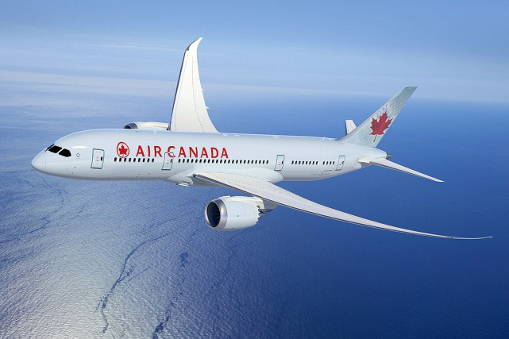
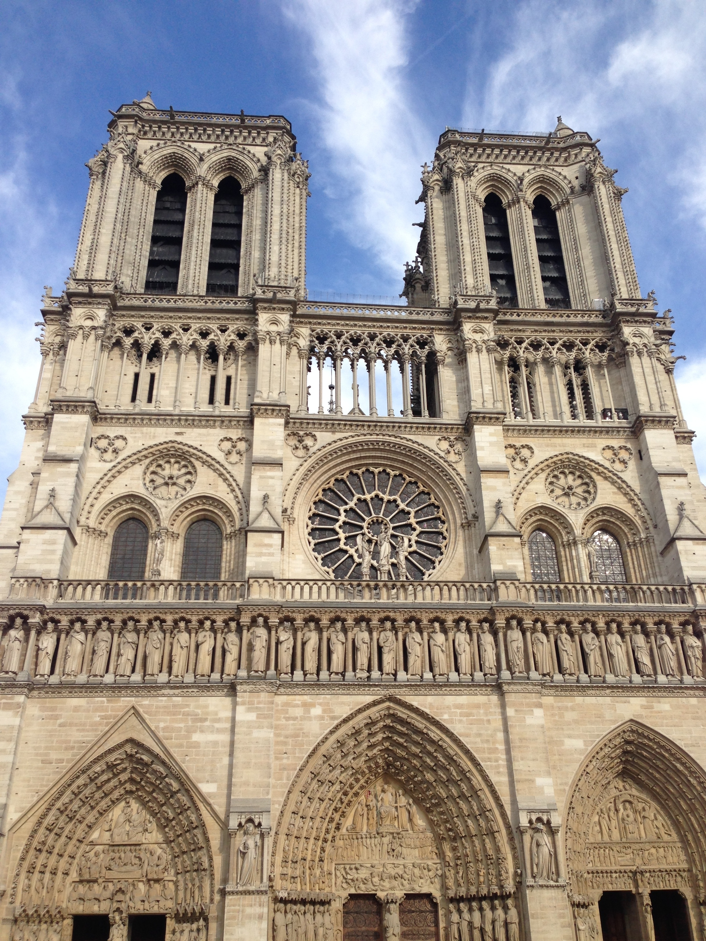
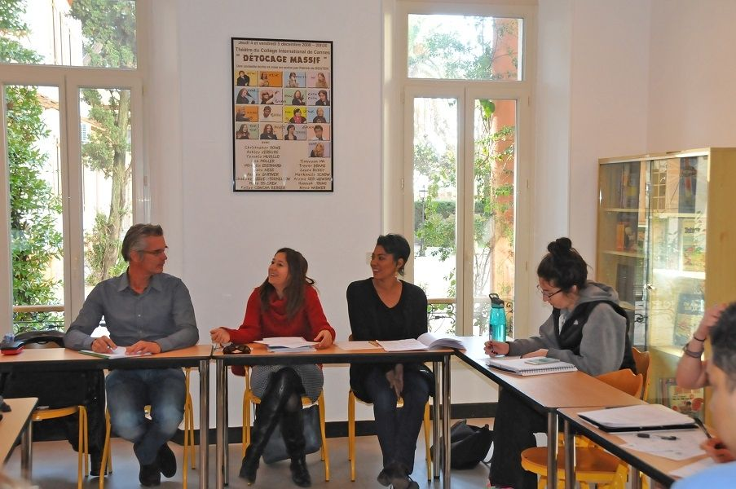
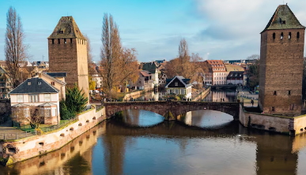
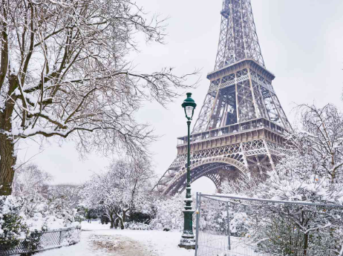
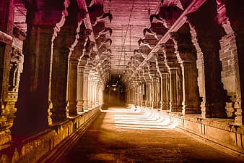
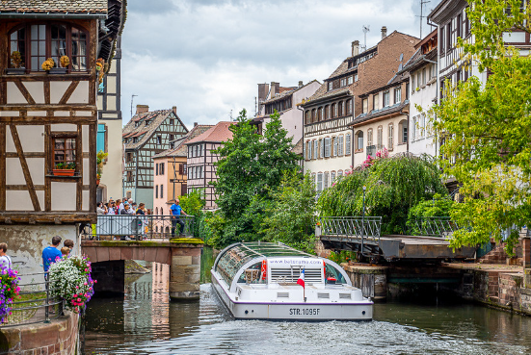
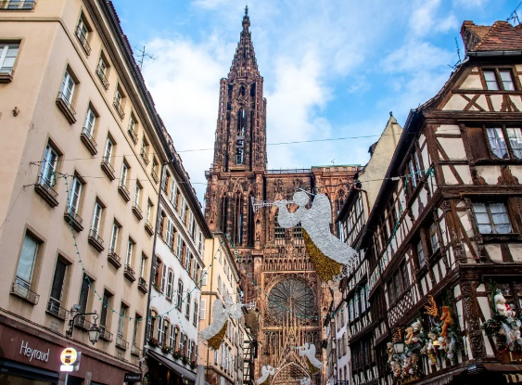
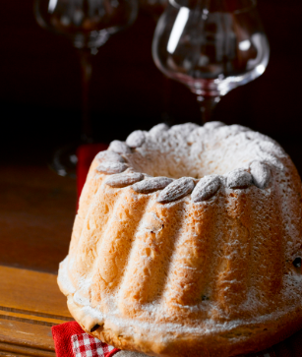
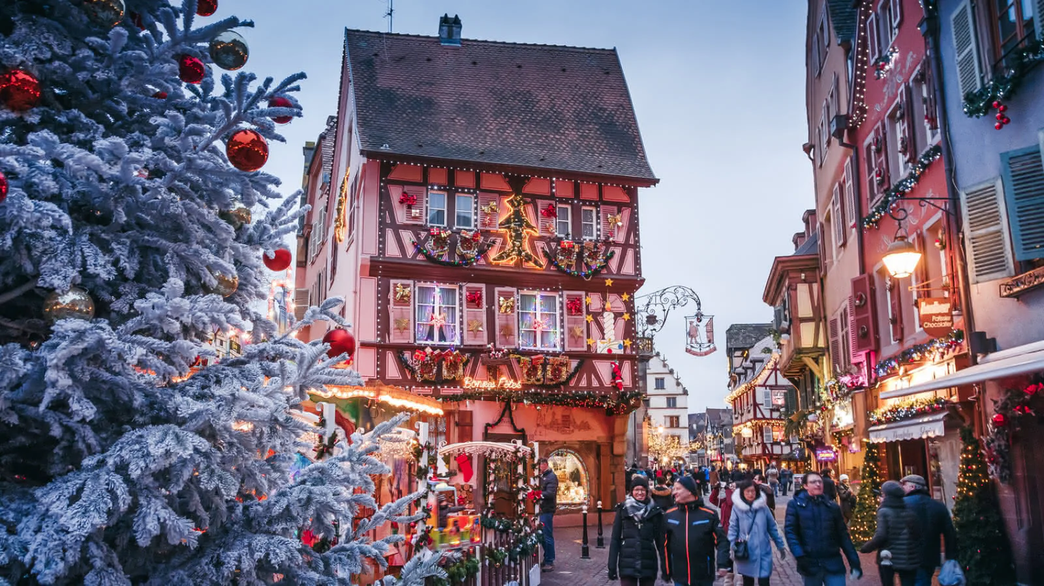
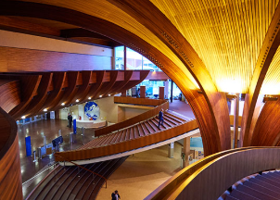
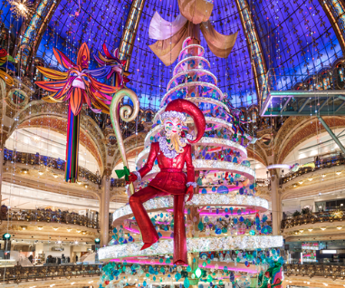
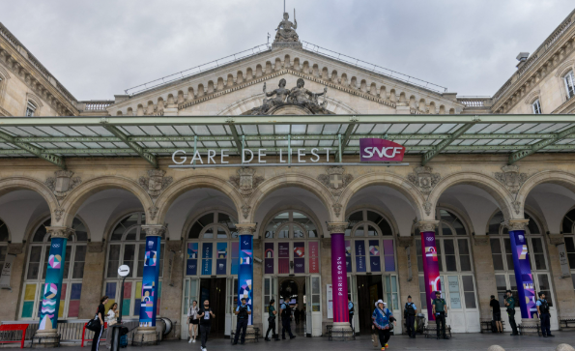
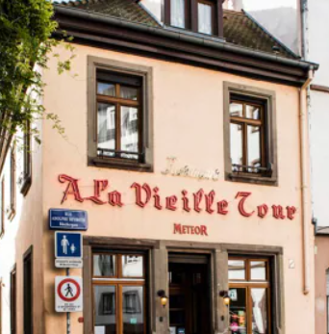
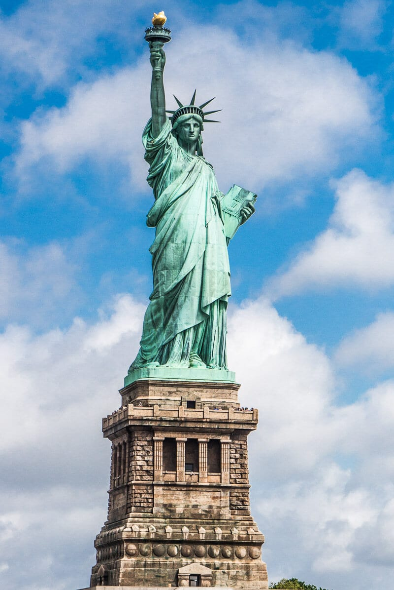
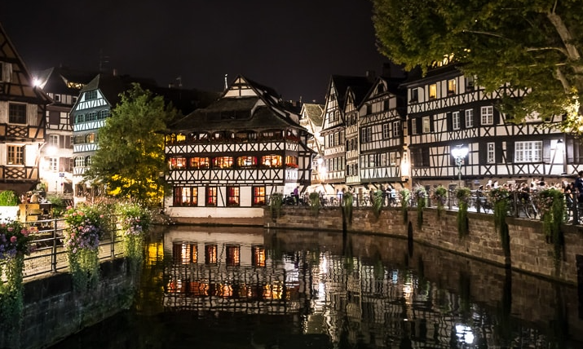
Calendar subject to change
Friday 5 Saturday 6 | Sunday 7 | Monday 8 | Tuesday 9 | Wednesday 10 | Thursday 11 | Friday 12 | Saturday 13 Sunday 14
April | April | April | April | April | May | May | May
Friday Overnight flight to Paris Saturday Eiffel Tower Galleries Lafayette Evening Evening Free time in Paris | AM Notre-Dame PM The Catacombs Leaving for Strasbourg by Train | AM French class 9am – 12pm | AM French class 9am – 12pm | AM French class 9am – 12pm | AM French class 9am – 12pm | AM French class 9am – 12pm PM Visit to the Conseil de l’Europe Evening Dinner at La Vieille Tour | Saturday AM Walk of Strasbourg’s Ponts Couverts Saturday PM Return to Paris by train - Last night in Paris Sunday Travelling back to New York City
 |  | PM Bateaux-mouches Quartier de la Petite-France | PM Cathédrale Notre-Dame/ Musée Alsacien | PM Baking workshop | PM Christmas market
 |  | Evening Free time | Evening Free time | Evening Free time | Evening Free time
2025

