Slide 1

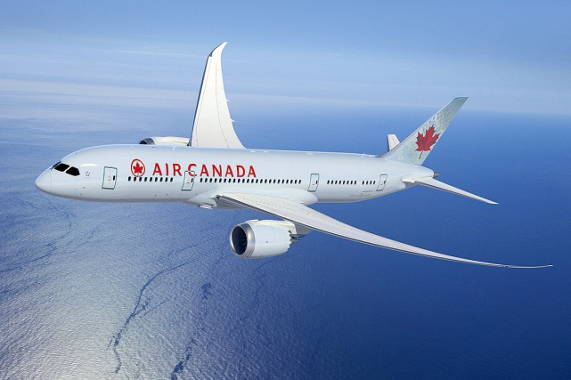
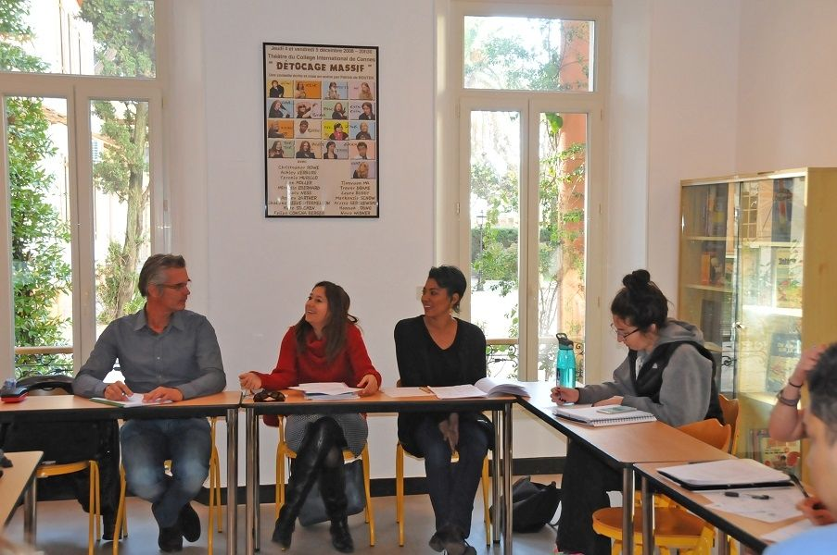
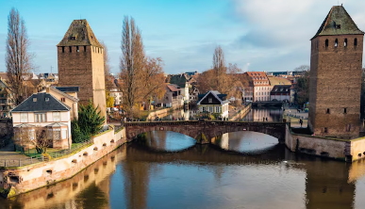
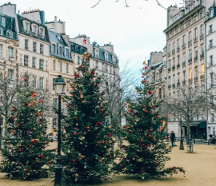
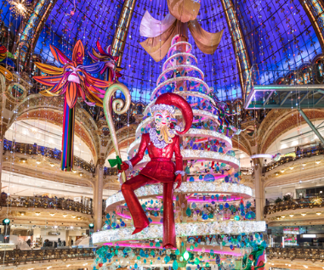
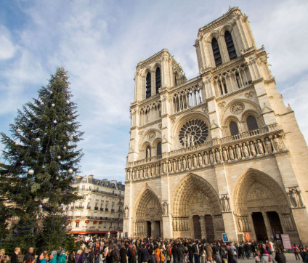
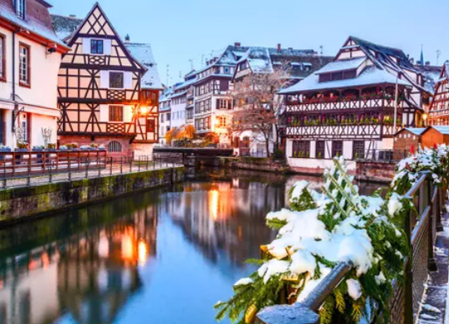
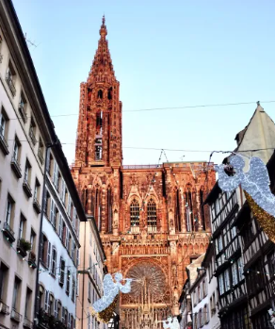
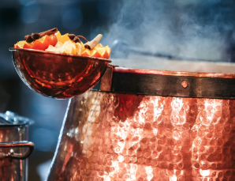
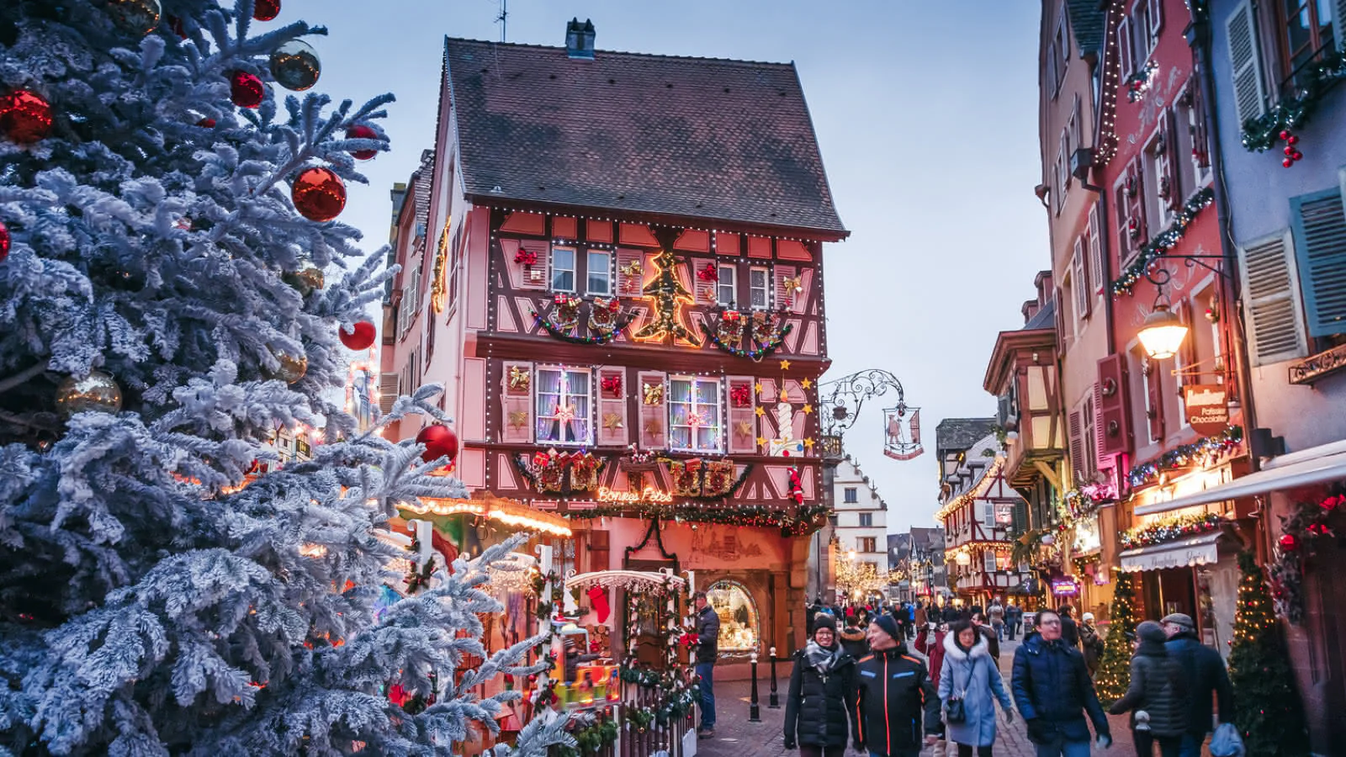
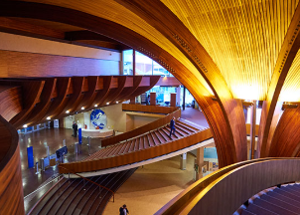
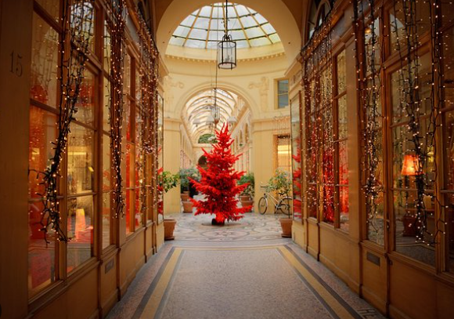
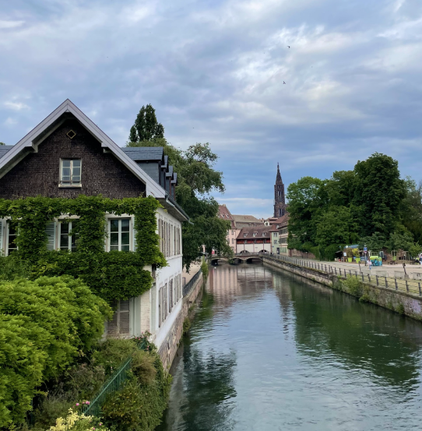
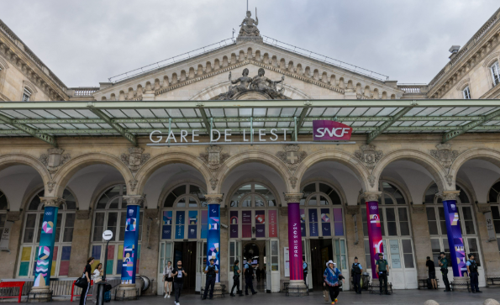
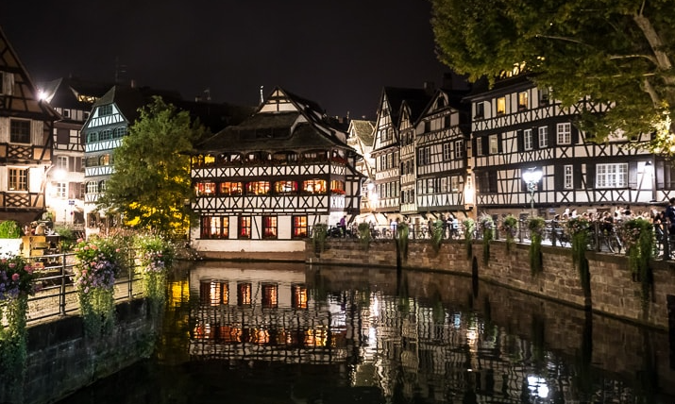
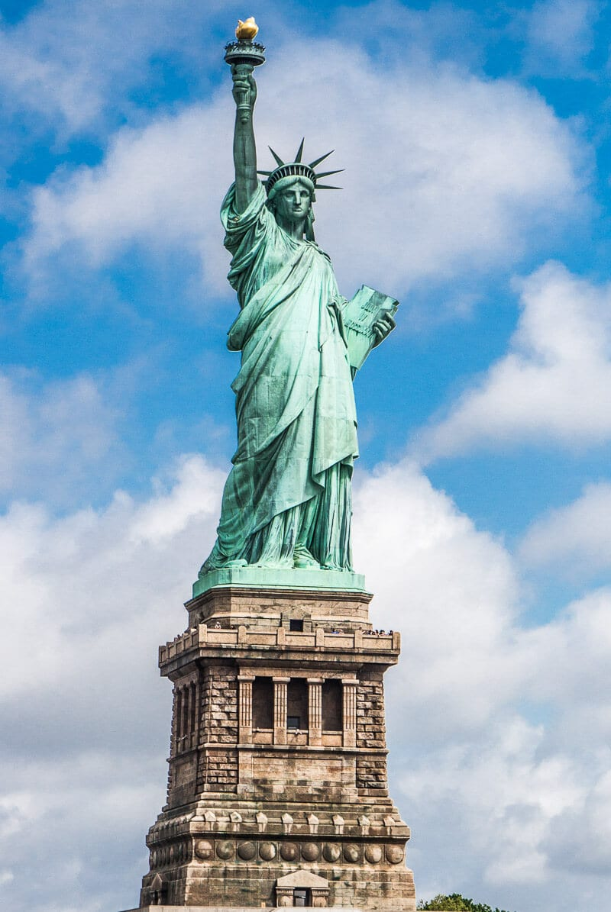
Calendar subject to change
Friday 5 Saturday 6 | Sunday 7 | Monday 8 | Tuesday 9 | Wednesday 10 | Thursday 11 | Friday 12 | Saturday 13 Sunday 14
December | December | December | December | December | December | December | December
Friday Overnight flight to Paris Saturday Galleries Lafayette Covered passages & Galleries Evening Free time in Paris | AM Quartier Latin & Ile de la Cité PM Notre-Dame Leaving for Strasbourg by Train | AM French class 9am – 1pm | AM French class 9am – 1pm | AM French class 9am – 1pm | AM French class 9am – 1pm | AM French class 9am – 1pm PM Visit to the Conseil de l’Europe Evening Dinner at L’Ami Schutz | Saturday AM Walk of Strasbourg’s Ponts Couverts Saturday PM Return to Paris by train - Last night in Paris Sunday Travelling back to New York City
 |  | PM Bateaux-mouches Quartier de la Petite-France | PM Cathédrale Notre-Dame/ Musée Alsacien | PM Tour de Gastronomie/ Vin de Noël | PM Marché de Noël Christkindelsmärik
 |  | Evening Free time | Evening Free time | Evening Free time | Evening Free time
2025

