Slide 1


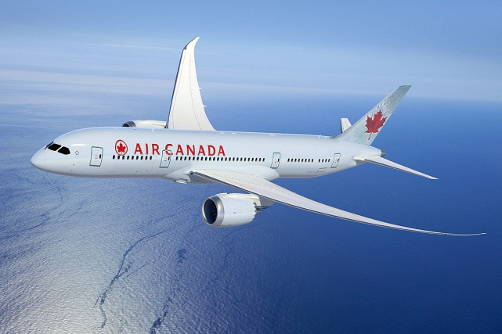
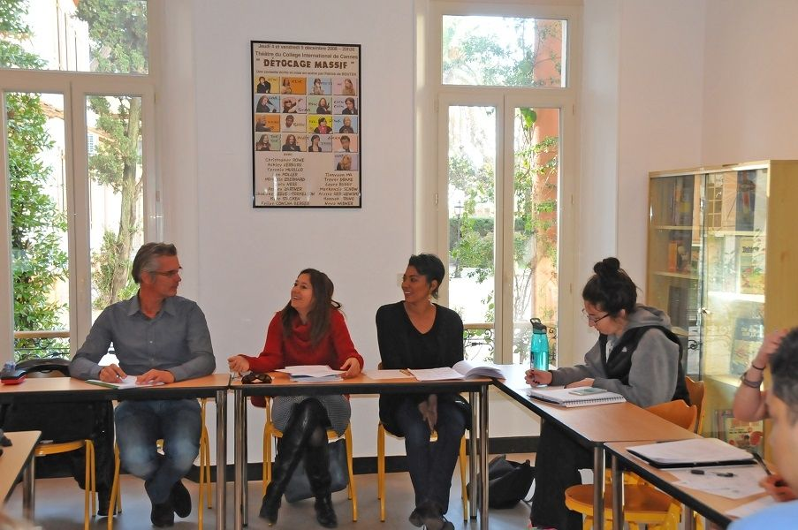
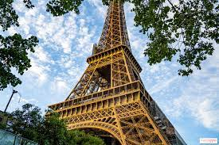
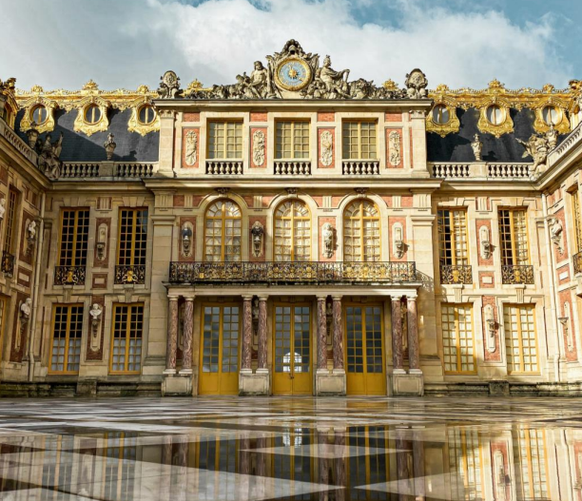
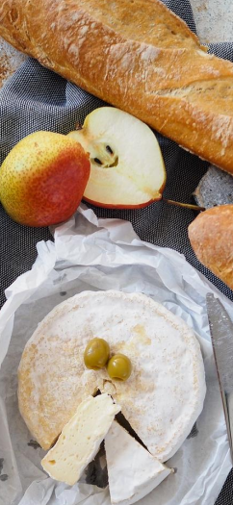
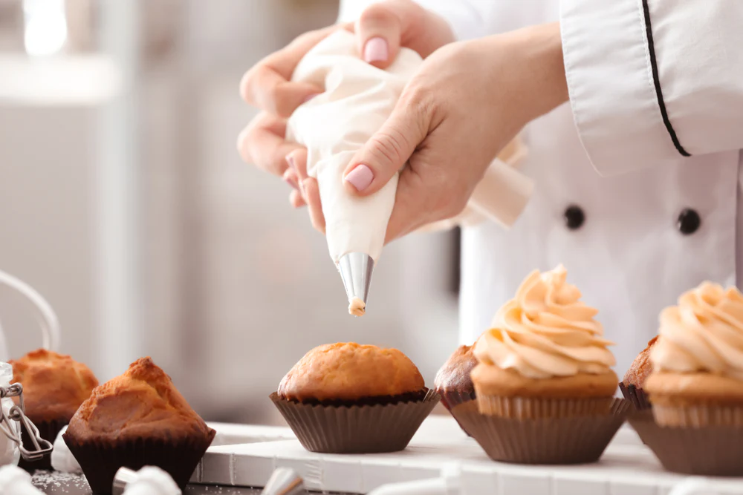
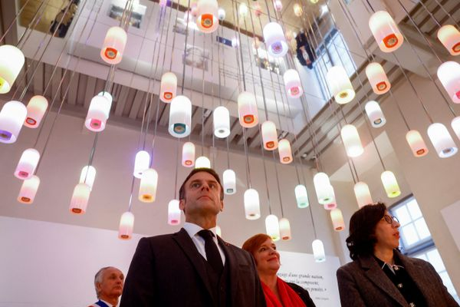
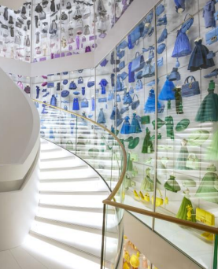
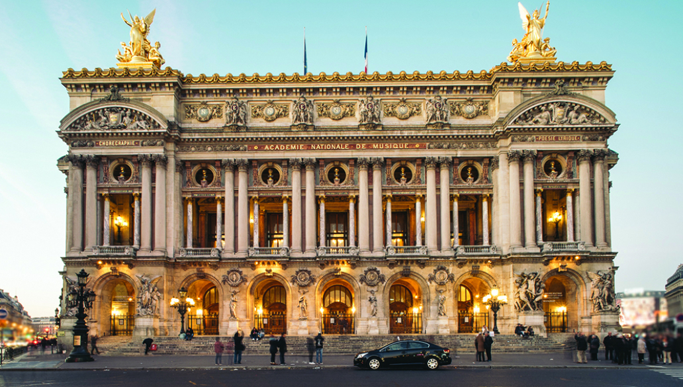
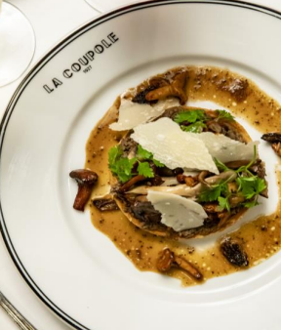
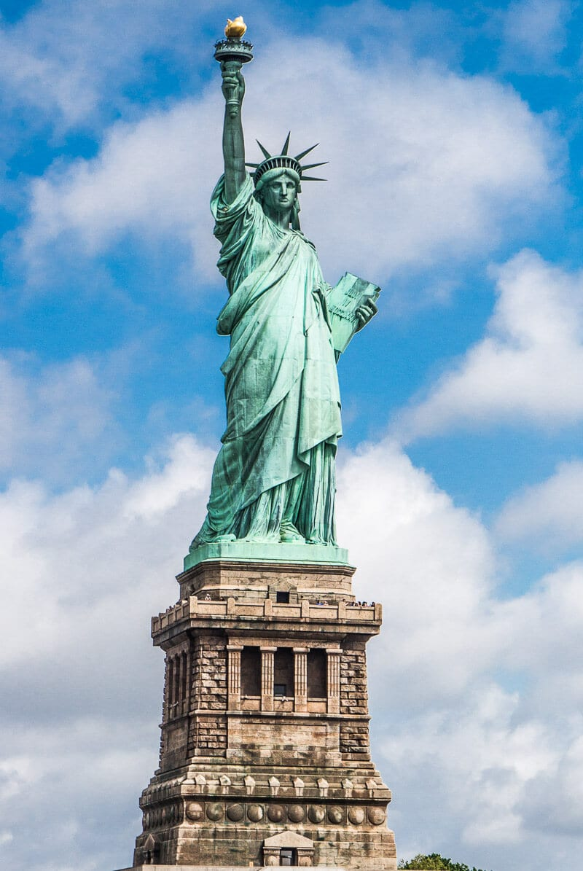
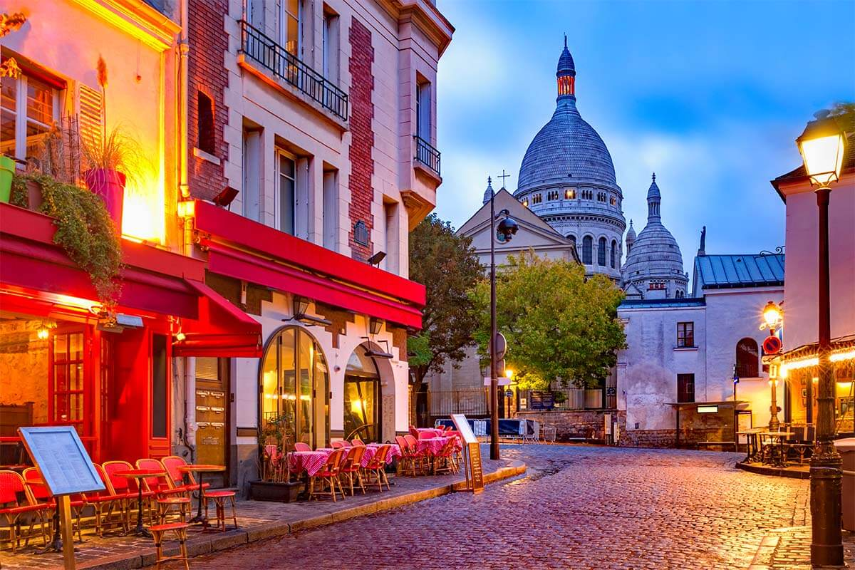
Calendar subject to change
Sunday 17 | Monday 18 | Tuesday 19 | Wednesday20 | Thursday 21 | Friday 22 | Saturday 23 | Sunday 24
August | August | August | August | August | August | August | August
Saturday Overnight flight to Paris Sunday Transfer to your 4-star hotel in the 5e Arrondissement Evening Free time | AM French Workshop La Mode Lunch Brasserie Parisienne PM 8e arrondissement Theme activity at the Dior Gallery Evening Free time | AM French Workshop La Gastronomie | AM Free time | AM French Workshop Les divertissements | All day Theme of the day : La langue française | All day Excursion To the Palace of Versailles Evening Dîner de Gala at La Couple | Sunday Free time Travelling back to New York City
 |  | Lunch Restaurant Michelin PM 5e arrondissement Cooking workshop | PM Cheese and bread tasting | Lunch Brasserie Parisienne PM 9e arrondissement Theme activity at the Opéra Garnier | Excursion to the Cité de la langue française
 |  | Evening Free time | Evening Free time | Evening Free time | Evening Free time
2025

