Slide 1


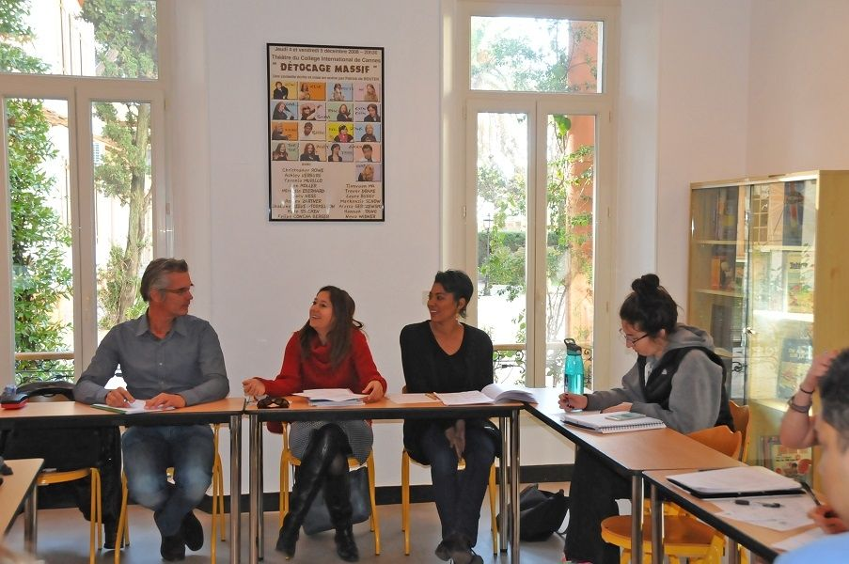
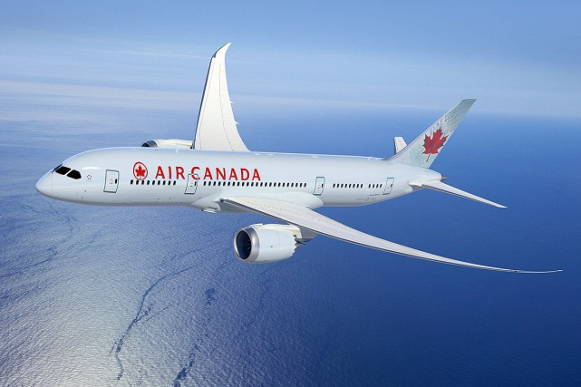
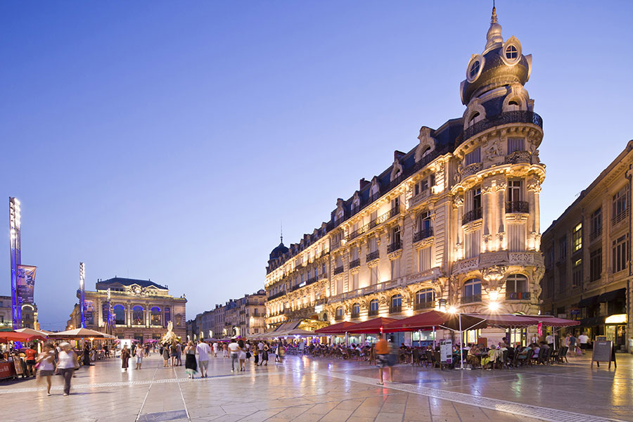
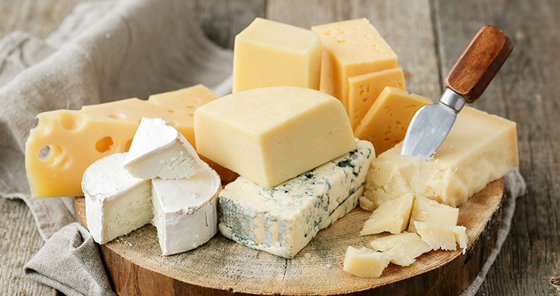
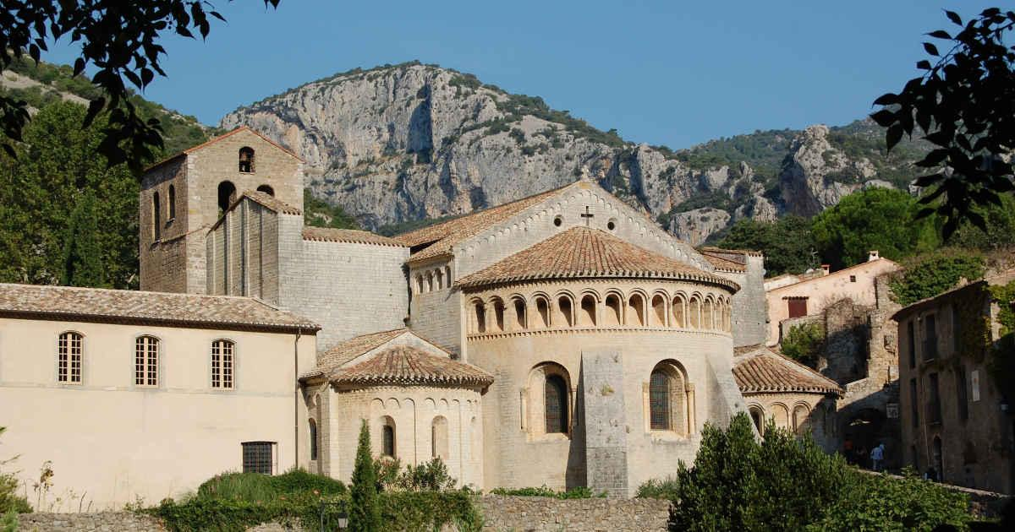
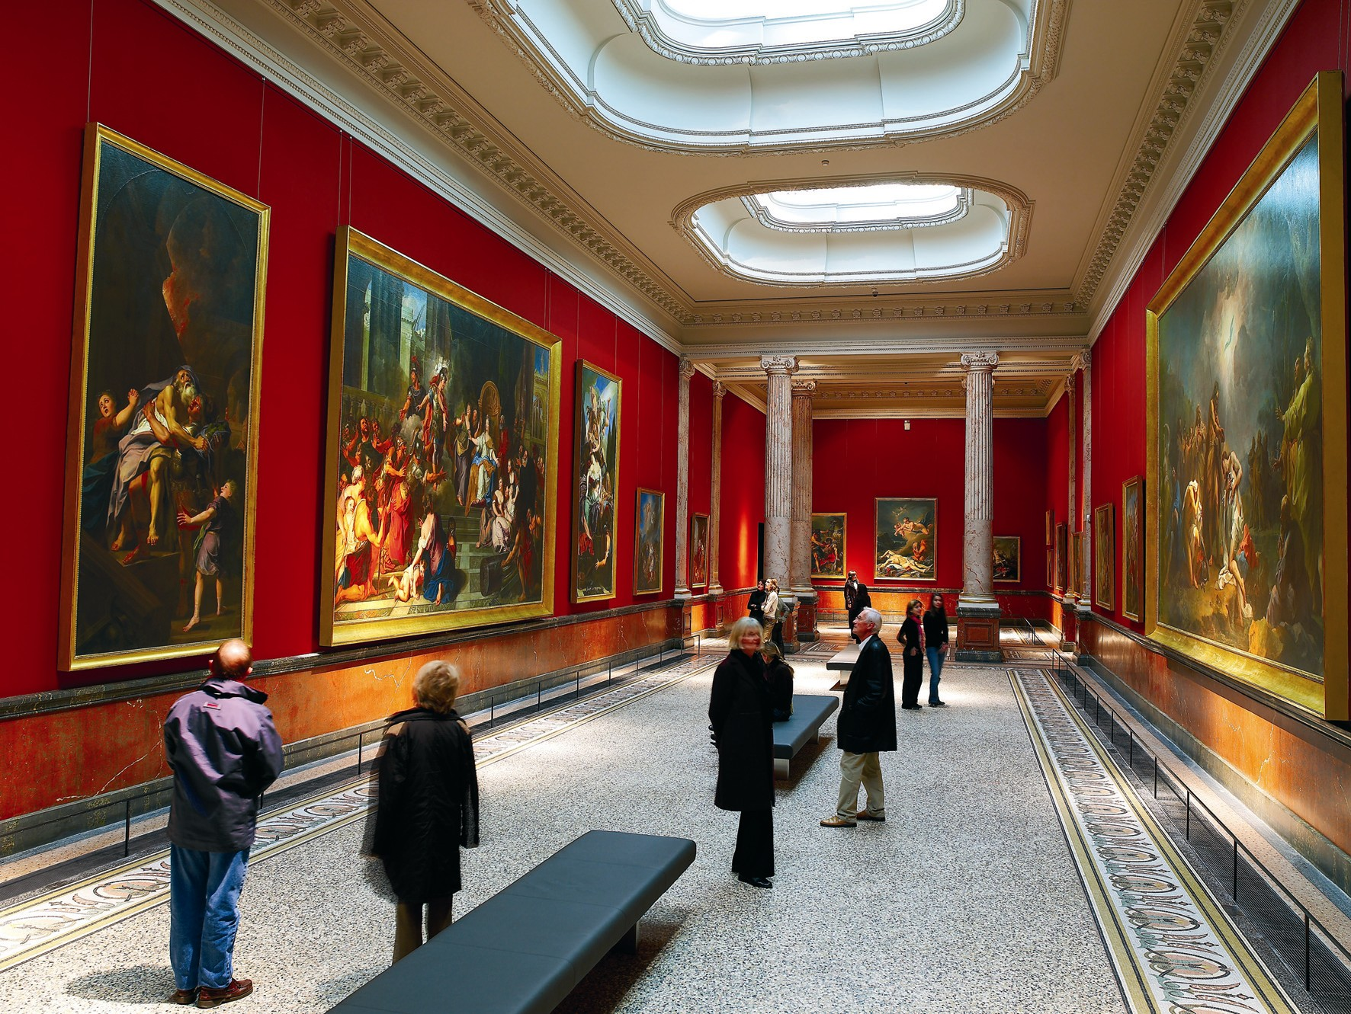
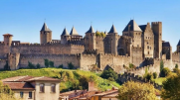
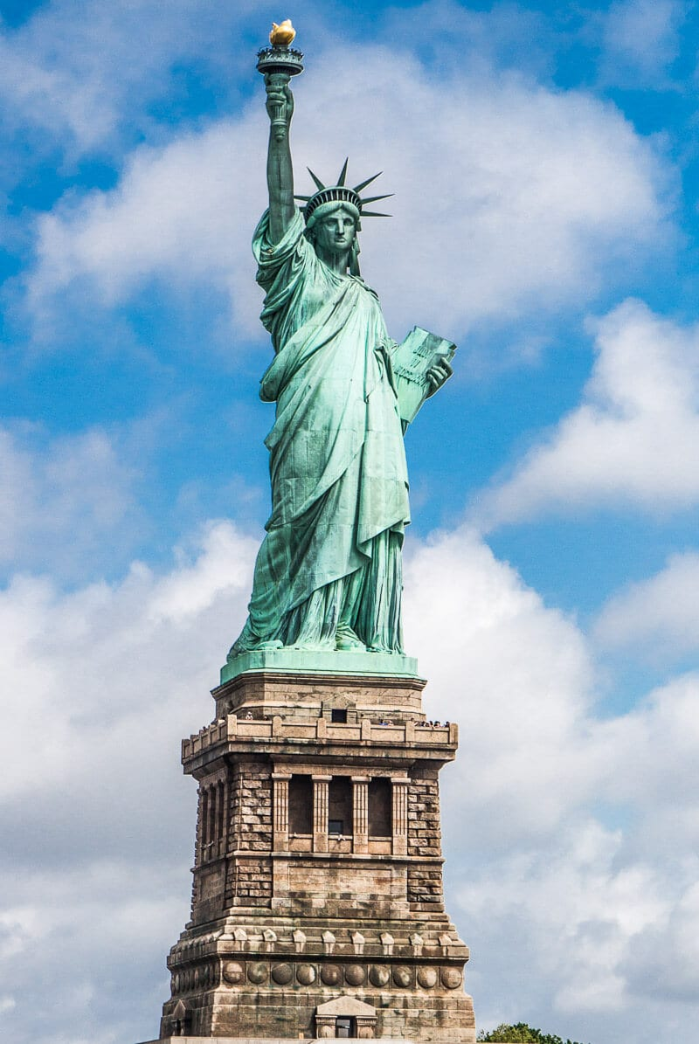
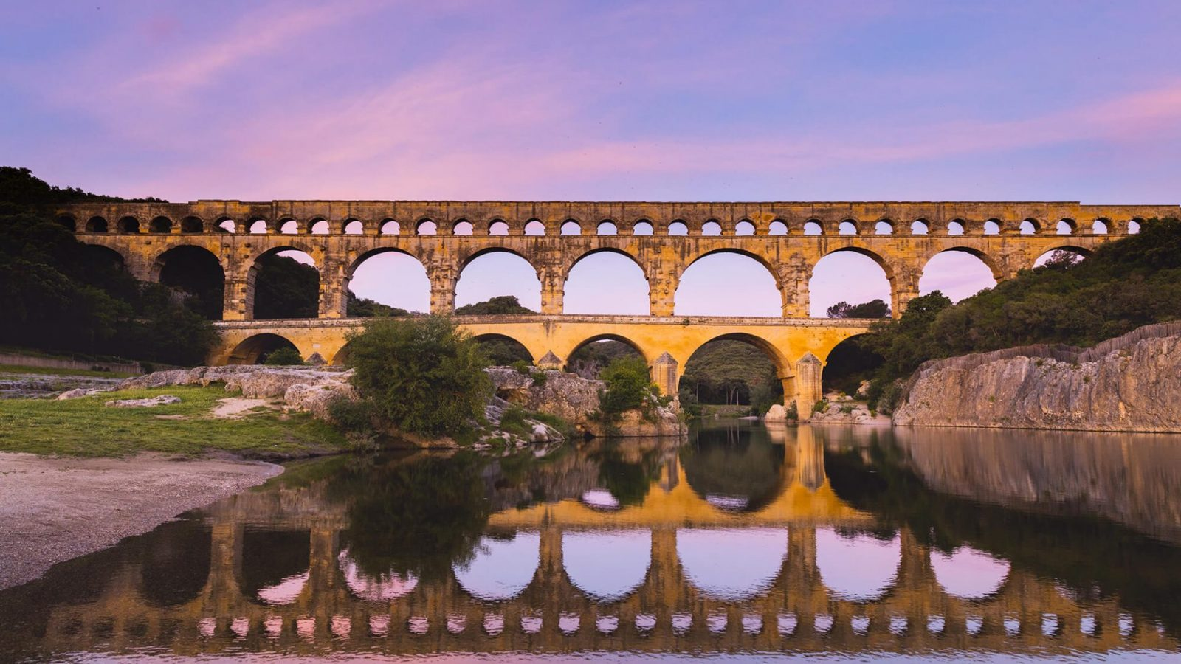
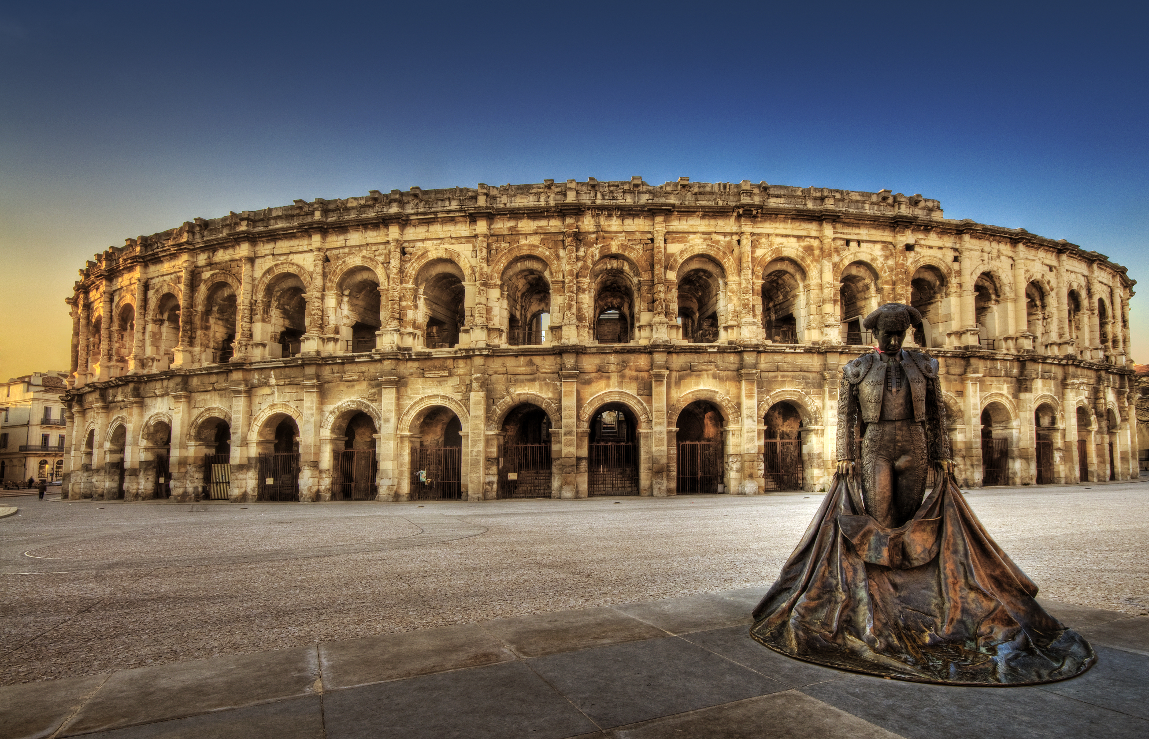
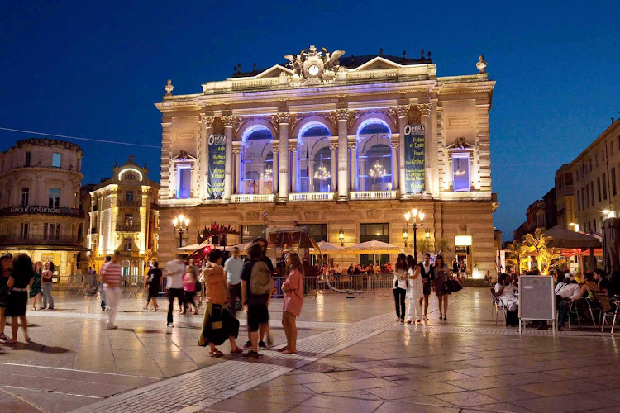
Calendar subject to change
Saturday 6 Sunday 7 | Monday 9 | Tuesday 10 | Wednesday 11 | Thursday 12 | Friday 13 | Saturday 14 | Sunday 15
September | September | September | September | September | September | September | September
Saturday Arrival day Travelling to Paris / Montpellier (overnight flight) Time to settle in + Free time Sunday Excursion to Nimes and the Pont du Gard | AM French class 9:15 – 12:15 PM Guided visit of Montpellier Evening Free time @ host family or hotel | AM French class 9:15 – 12:15 | AM French class 9:15 – 12:15 | AM French class 9:15 – 12:15 | AM French class 9:15 – 12:15 | All day Excursion to Carcassonne Evening Free time @ host family or hotel | Departure day All day Travelling back to New York City
 |  | PM Cheese & wine tasting | PM Free time / shopping / beach | PM Excursion to St-Guilhem-le-desert | PM Visit of the Museum Fabre
 |  | Evening Free time @ host family or hotel | Evening Free time @ host family or hotel | Evening Free time @ host family or hotel | Evening Free time @ host family or hotel
2025

