Slide 1


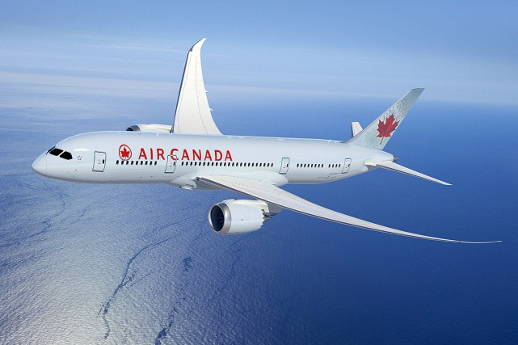
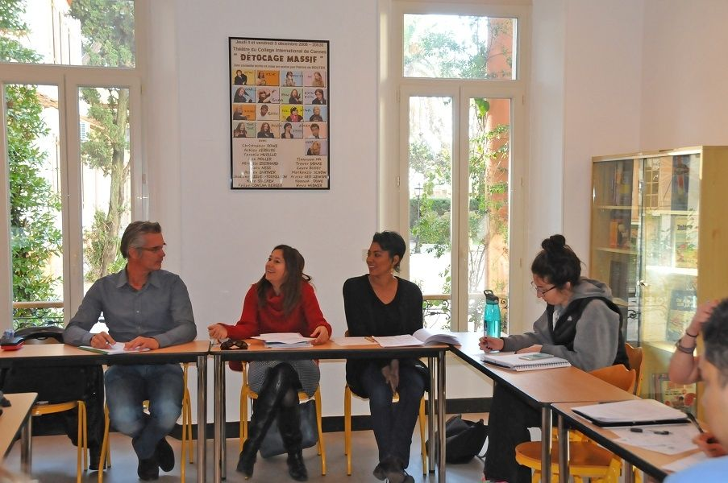
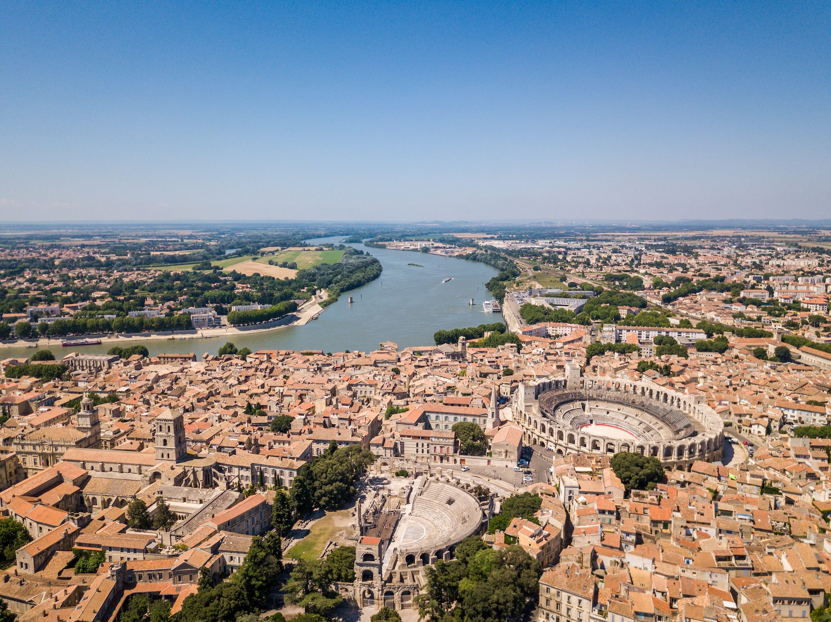
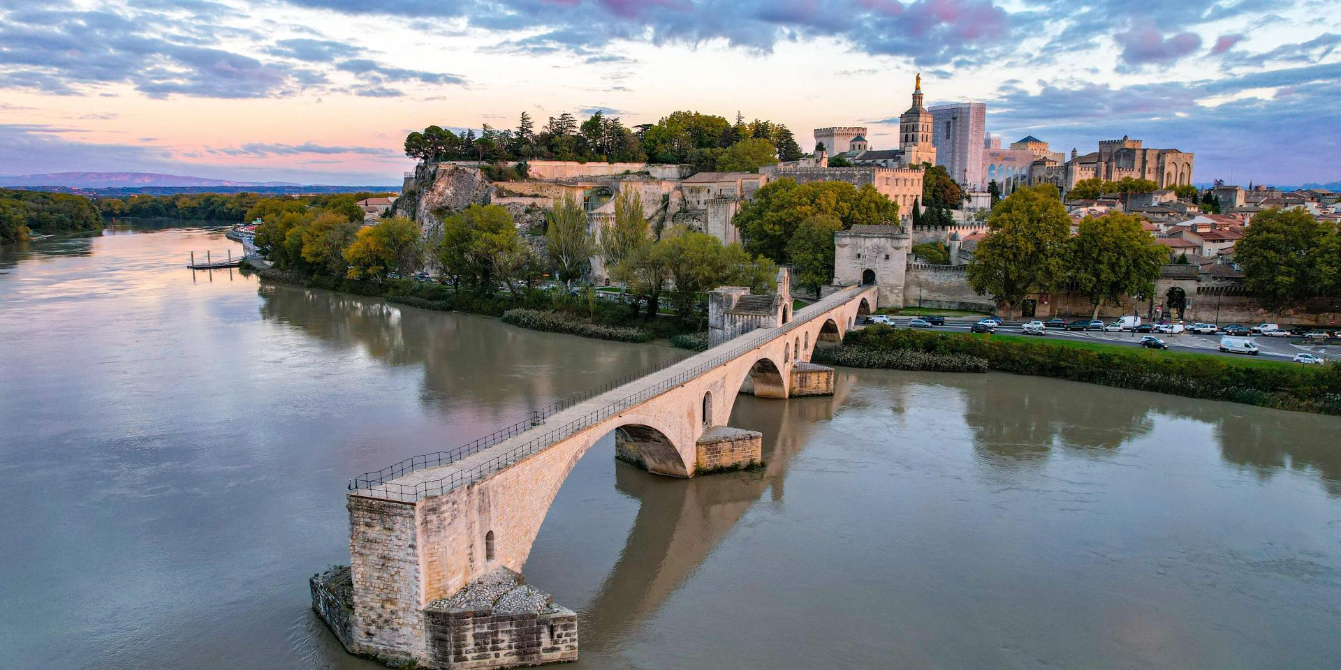
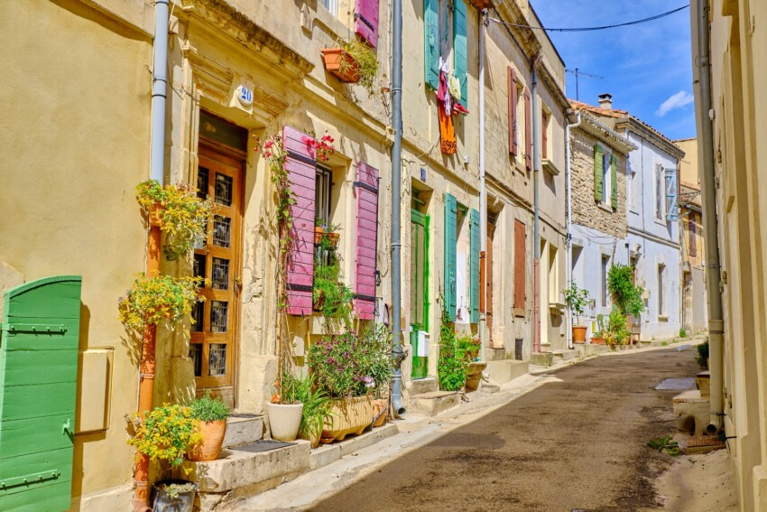
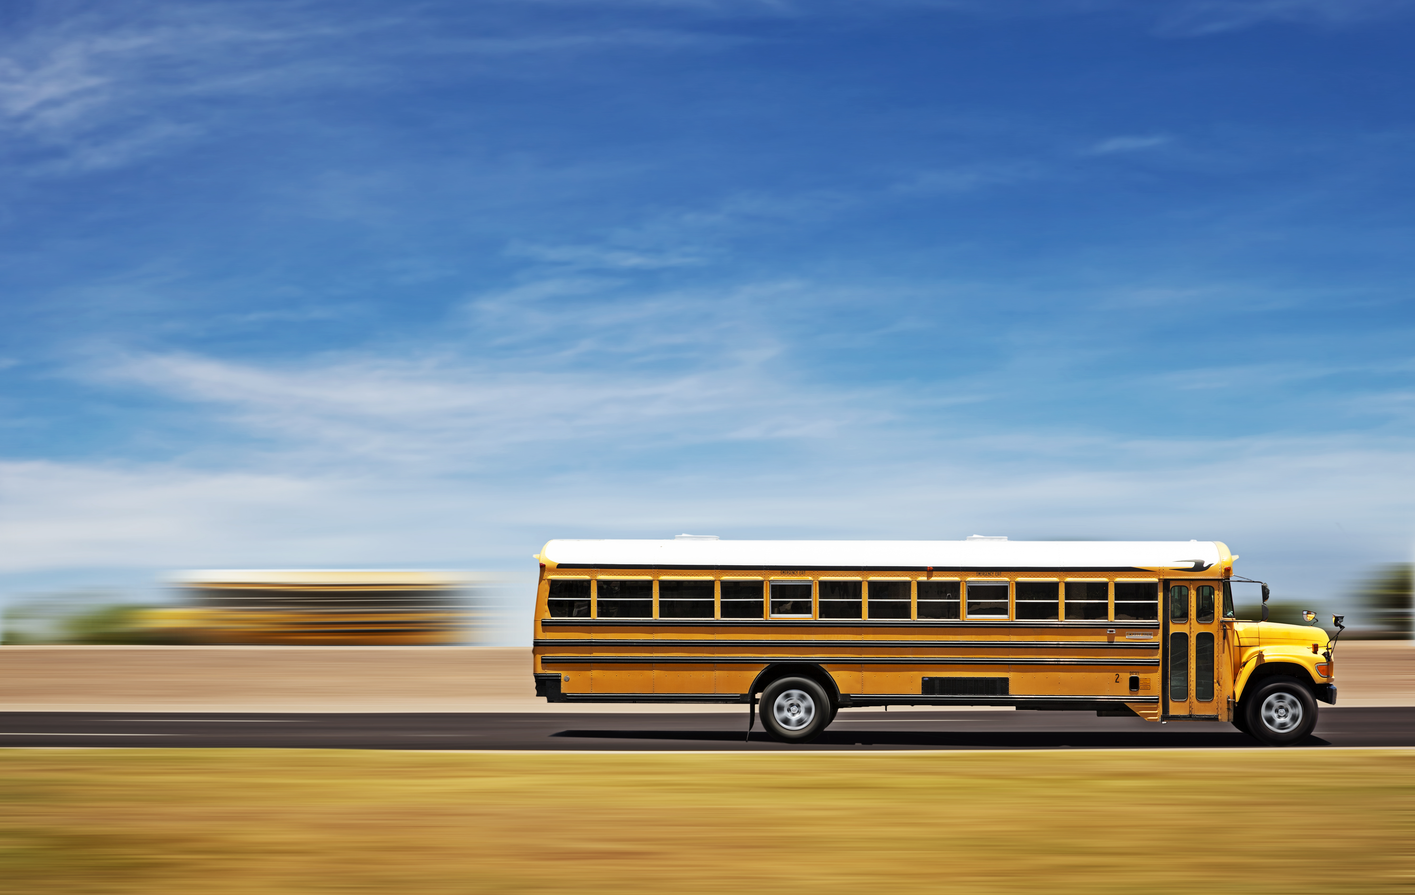
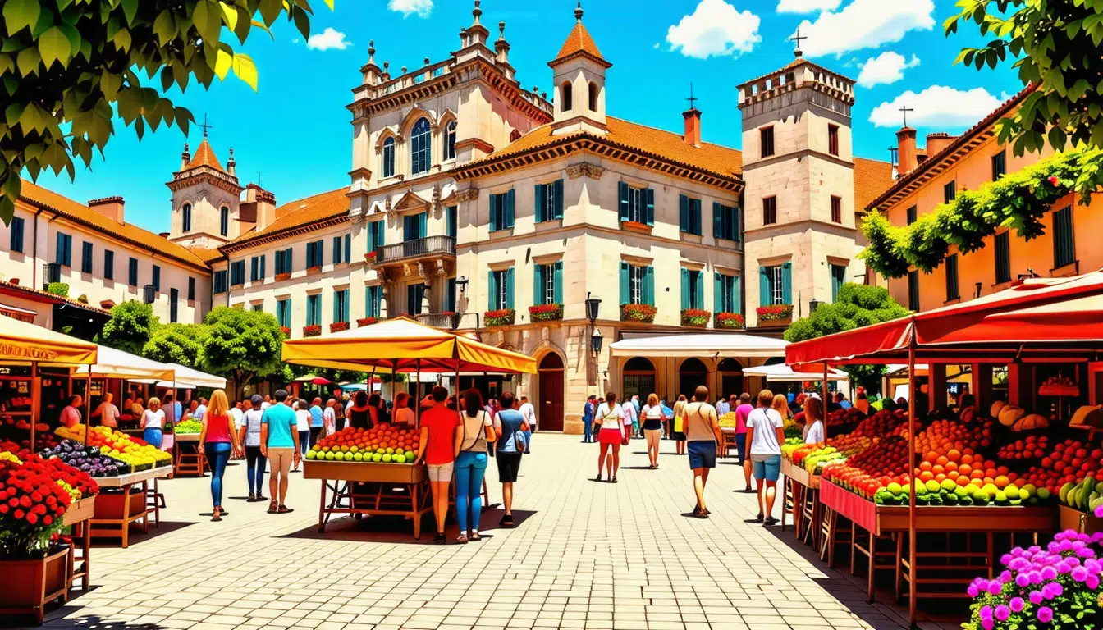
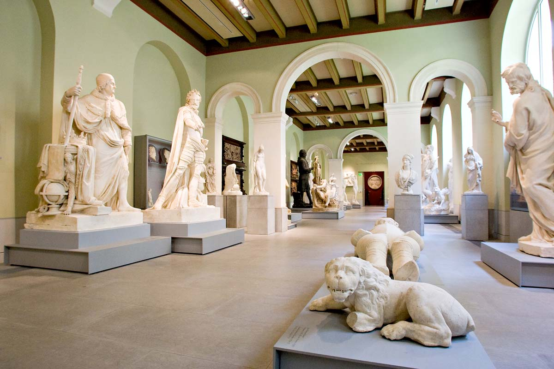
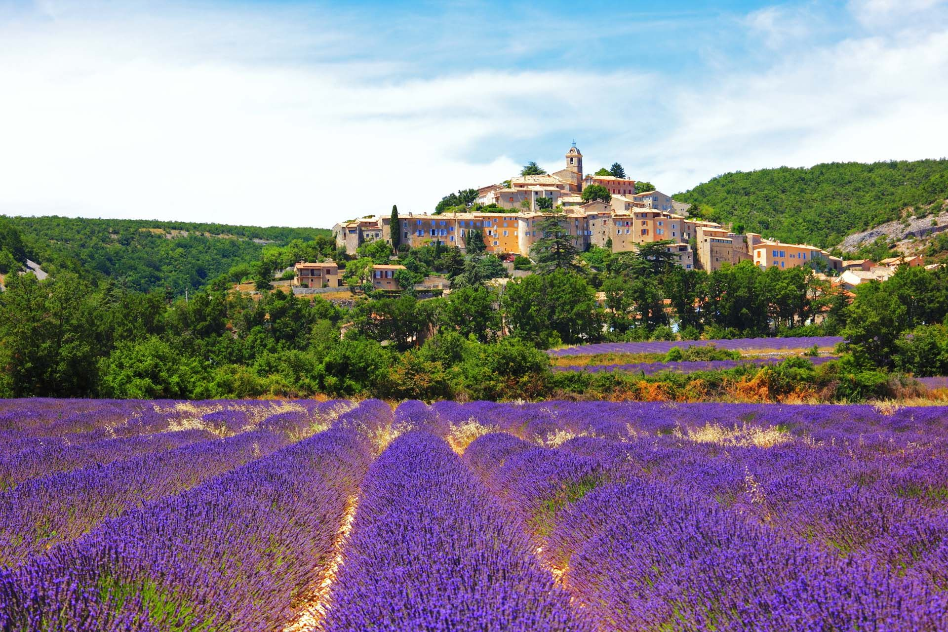
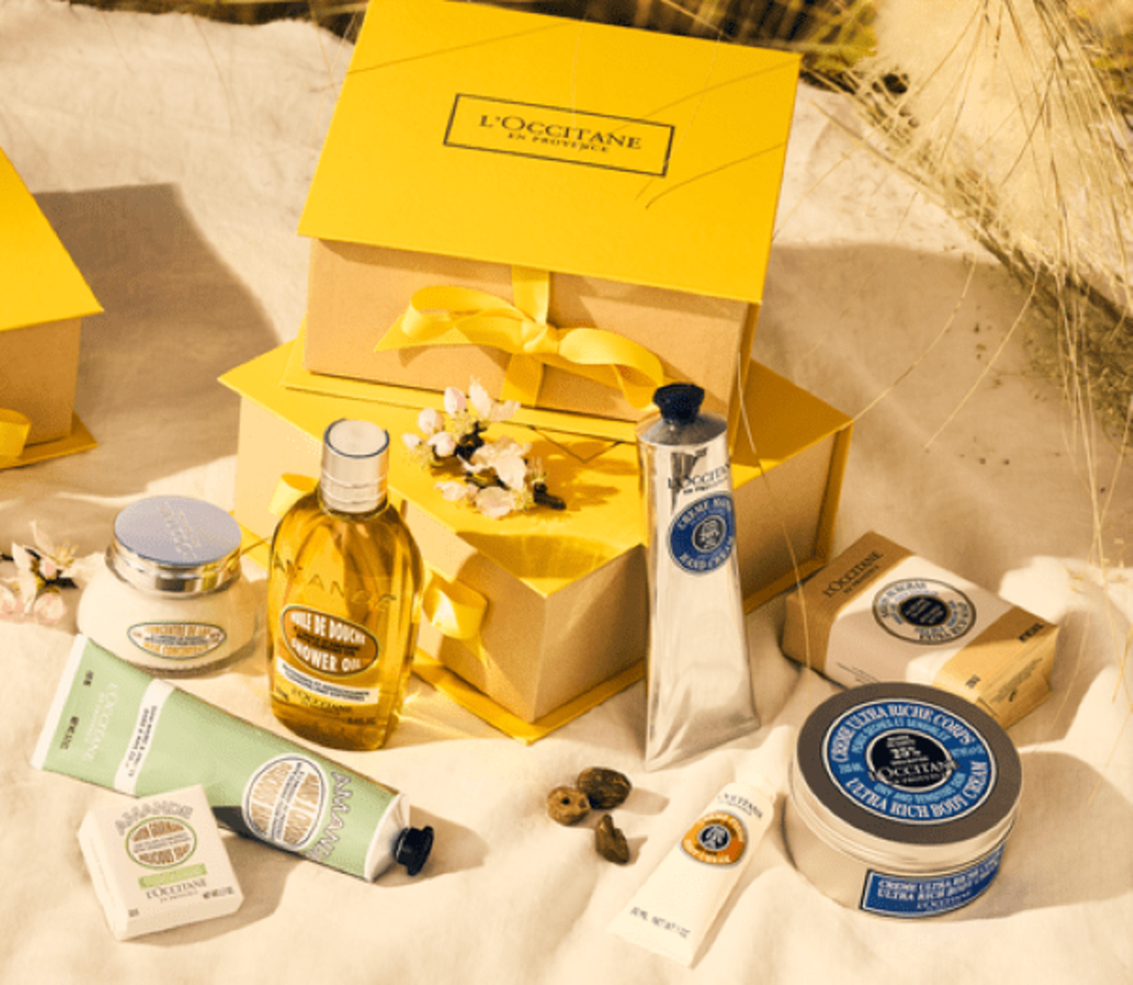
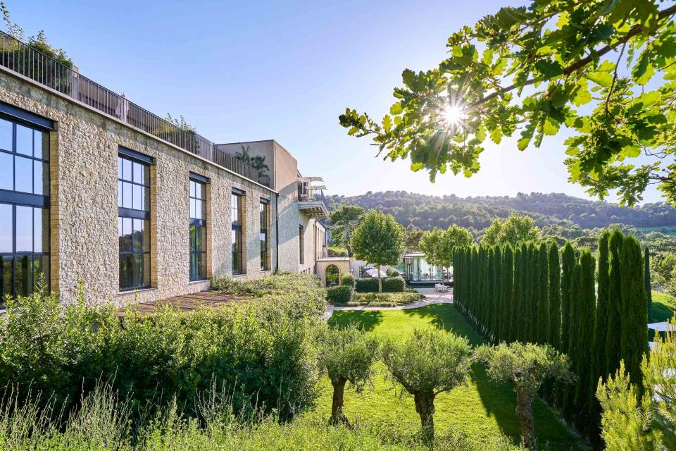
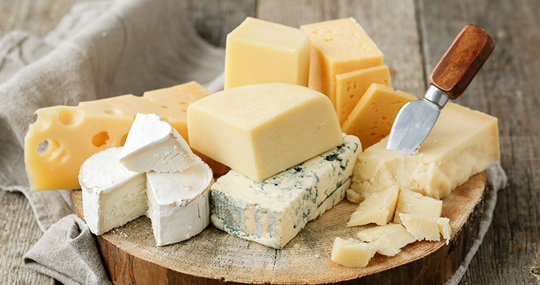
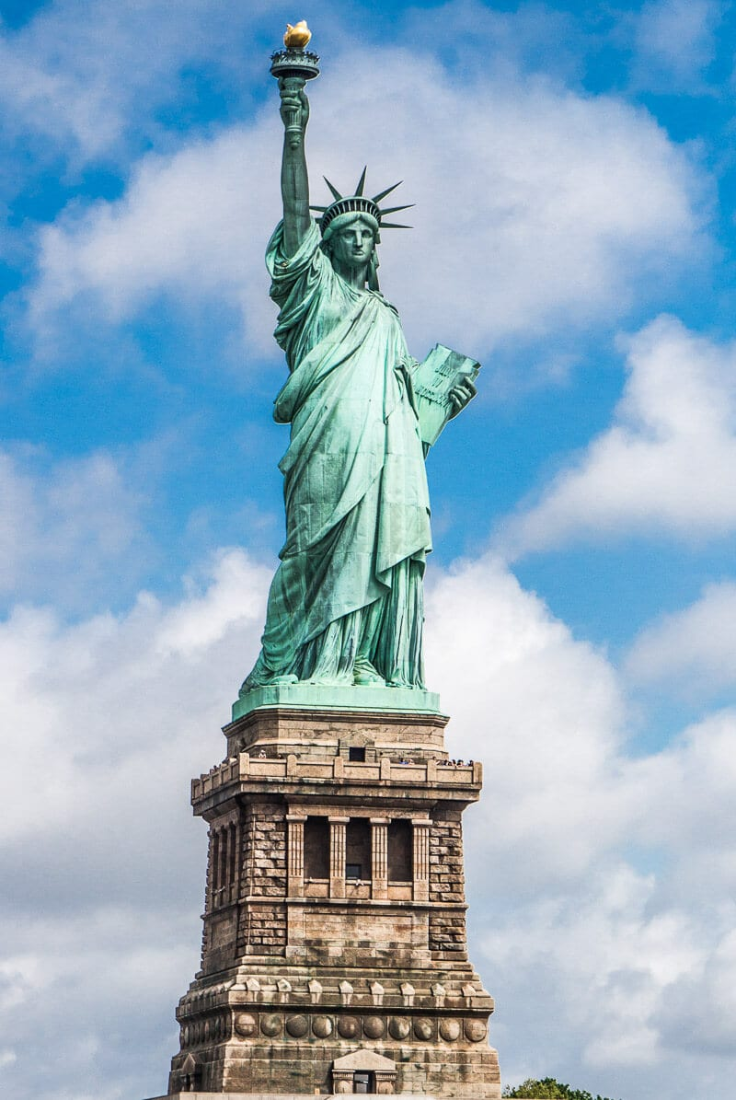
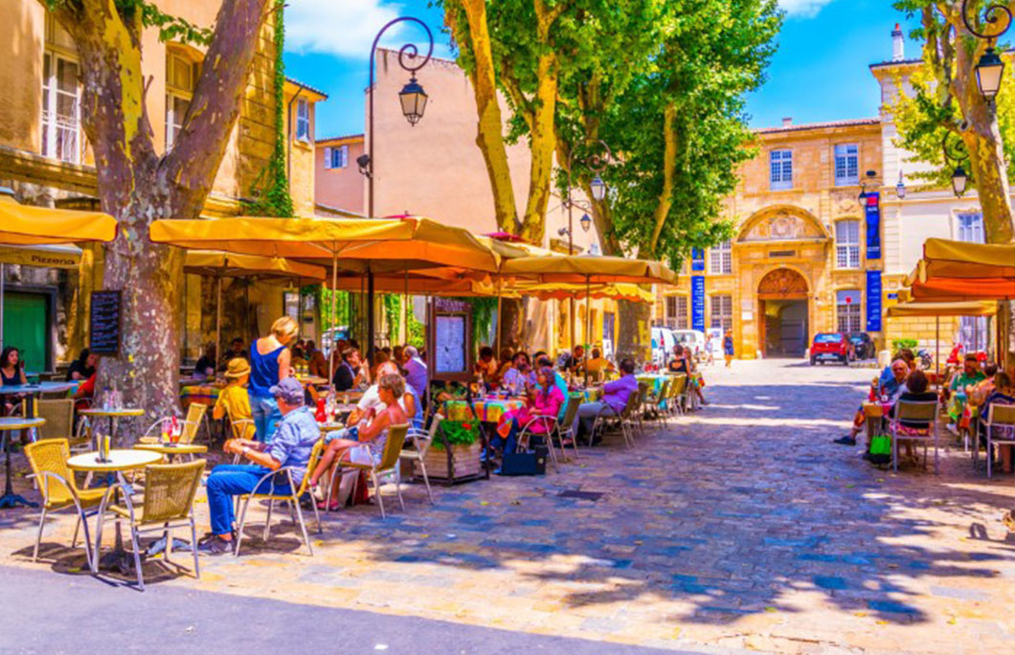
Calendar subject to change
Friday 23 Saturday 24 | Sunday 25 | Monday 26 | Tuesday 27 | Wednesday 28 | Thursday 29 | Friday 30 | Saturday 31 Sunday 1
May | May | May | May | May | May | May | May/June
Friday Overnight flight to Nice Saturday Transfer to Aix-en-Provence by private transportation Rest of the day Free time | AM Excursion to the City of Avignon Evening Free time | AM French class 9am – 1pm | AM French class 9am – 1pm | AM French class 9am – 1pm | AM French class 9am – 1pm | AM French class 9am – 1pm PM Wine and cheese tasting Evening Free time | Saturday Excursion to the City of Arles Sunday Travelling back to New York City
 |  | PM Guided visit of the Museum Granet | PM Visit lavender fields & soap wokshop | PM Visit of L’Occitane factory | PM Visit of the Castle La Coste (Wine estate)
 |  | Evening Free time | Evening Free time | Evening Free time | Evening Free time
2025

